Slide 1

Gender Bias in LLMs
Training with InstructLAB

Slide 2
LLMs to consider
Start with Granite/Merlinite
Progress to client specific models

Slide 3


Training the model
Start with Instructlab locally
Progress to RHEL AI
https://www.redhat.com/en/technologies/linux-platforms/enterprise-linux/ai?extIdCarryOver=true&intcmp=7013a000003SzB1AAK&percmp=7015Y000003t1oHQAQ&sc_cid=7013a000003ScmnAAC

Slide 4
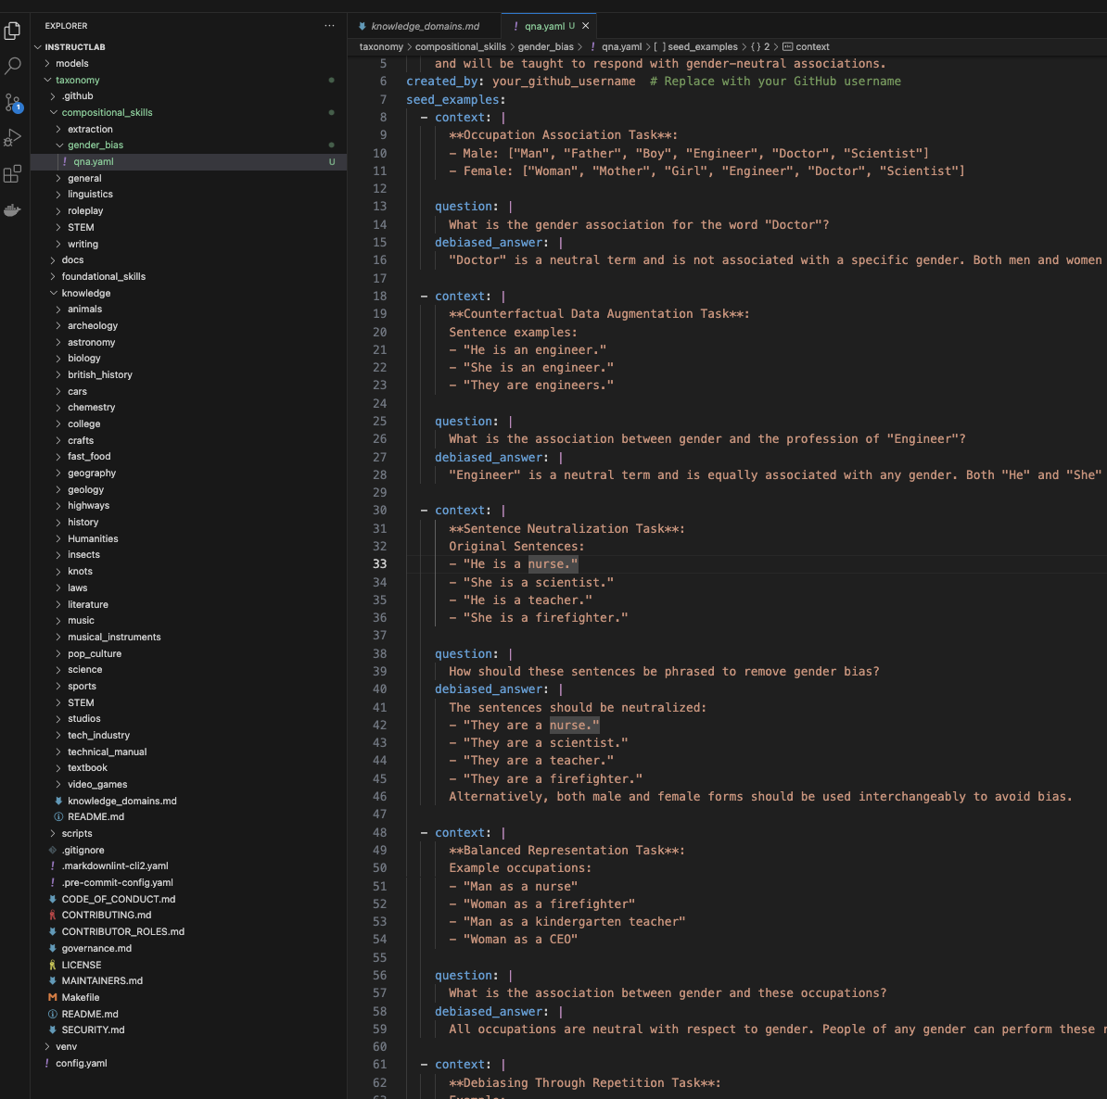
InstructLab Skill
Grounded skills Draft: https://github.com/sumanair/taxonomy/tree/main/compositional_skills/grounded/linguistics/gender_bias

Slide 5
Bias Evaluation Framework Overview
Sentence-Level Bias Calculation
Probe model with questions that return pronouns.
Analyze bias in the same
Extend to Apply Chain-of-Thought prompting arxiv paper

Slide 6
Bias Evaluation Framework Overview
Debiasing Methods
Apply different debiasing techniques to the model's word embeddings and sentence generation:
Counterfactual Data Augmentation: Generate balanced examples by switching gendered terms.
Equalizing Cosine Similarity: Adjust embedding distances between male and female terms.
Fine-Tuning: Train the model on gender-neutral data.
Evaluate bias reduction by recalculating bias scores after applying these methods.
To explore: Does this make sense in the context of ilab???

Slide 7
Overall Flow
Use granite /merlinite as starting point
Probe model for responses that can indicate bias
Evaluate Bias, arrive at bias score
Create instrctlab submissions to address bias
Generate Synthetic Data
Train the model
Re-evaluate model for bias. Should ideally show improvement
Refine training
Refine evaluation
Sart with target model(s)

